Slide 1
Introduction to Differential Equations – Lecture 16
Fei Qi
fei.qi@du.edu
https://feiqimath.github.io

Slide 2
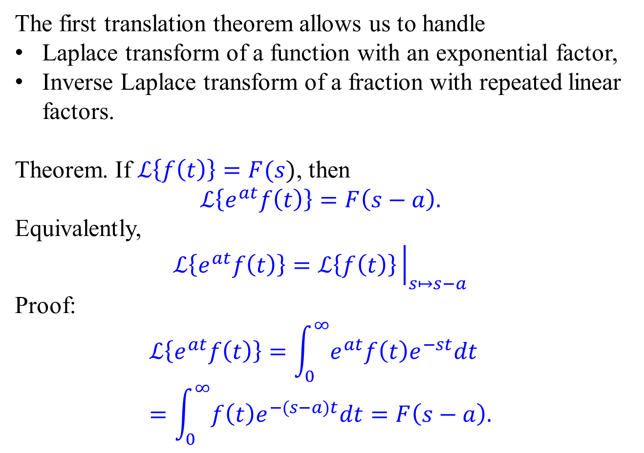
First Translation Theorem
The first translation theorem allows us to handle
Laplace transform of a function with an exponential factor,
Inverse Laplace transform of a fraction with repeated linear factors.
Theorem. If $ℒ\left\{f\left(t\right)\right\}=F(s)$, then
$$ℒ\left\{e^{at}f\left(t\right)\right\}=F\left(s−a\right).$$
Equivalently,
$$ℒ\left\{e^{at}f\left(t\right)\right\}=ℒ\left\{f\left(t\right)\right\}{\left.​\right|}_{s↦s−a}$$
Proof:
$$ℒ\left\{e^{at}f\left(t\right)\right\}=\int_{0}^{∞}{e^{at}f\left(t\right)e^{−st}dt} \\ =\int_{0}^{∞}{f\left(t\right)e^{−(s−a)t}dt}=F\left(s−a\right).$$

Slide 3
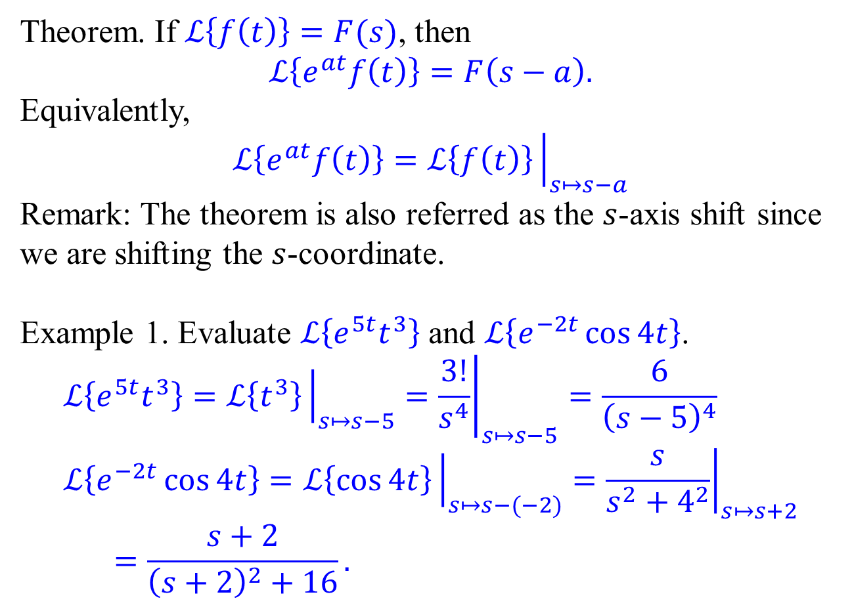
First Translation Theorem – Applications
Theorem. If $ℒ\left\{f\left(t\right)\right\}=F(s)$, then
$$ℒ\left\{e^{at}f\left(t\right)\right\}=F\left(s−a\right).$$
Equivalently,
$$ℒ\left\{e^{at}f\left(t\right)\right\}=ℒ\left\{f\left(t\right)\right\}{\left.​\right|}_{s↦s−a}$$
Remark: The theorem is also referred as the $s$-axis shift since we are shifting the $s$-coordinate.
Example 1. Evaluate $ℒ\left\{e^{5t}t^{3}\right\}$ and $ℒ\left\{e^{−2t}\cos{4t}\right\}$.
$$ℒ\left\{e^{5t}t^{3}\right\}=ℒ\left\{t^{3}\right\}{\left.​\right|}_{s↦s−5}={\left.\frac{3!}{s^{4}}\right|}_{s↦s−5}=\frac{6}{{\left(s−5\right)}^{4}} \\ ℒ\left\{e^{−2t}\cos{4t}\right\}=ℒ\left\{\cos{4t}\right\}{\left.​\right|}_{s↦s−(−2)}={\left.\frac{s}{s^{2}+4^{2}}\right|}_{s↦s+2} \\ =\frac{s+2}{{\left(s+2\right)}^{2}+16}.$$

Slide 4

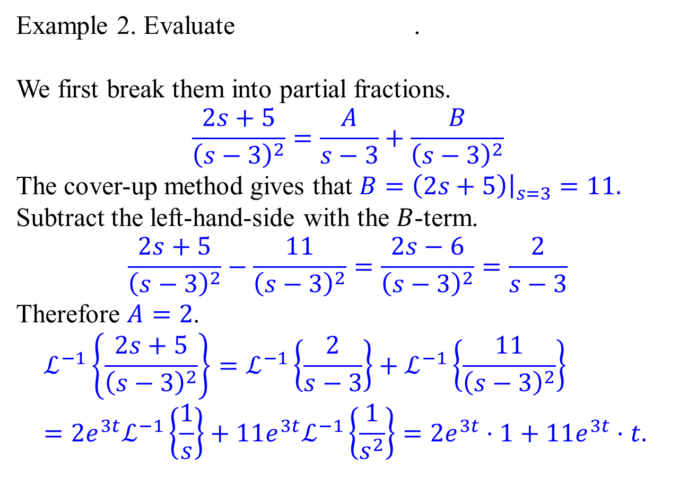
First Translation Theorem – Applications
$$ℒ^{−1}\left\{\frac{2s+5}{{\left(s−3\right)}^{2}}\right\}$$
Example 2. Evaluate .
We first break them into partial fractions.
$$\frac{2s+5}{{\left(s−3\right)}^{2}}=\frac{A}{s−3}+\frac{B}{{\left(s−3\right)}^{2}}$$
The cover-up method gives that $B=\left(2s+5\right){\left.​\right|}_{s=3}=11.$
Subtract the left-hand-side with the $B$-term.
$$\frac{2s+5}{{\left(s−3\right)}^{2}}−\frac{11}{{\left(s−3\right)}^{2}}=\frac{2s−6}{{\left(s−3\right)}^{2}}=\frac{2}{s−3}$$
Therefore $A=2$.
$$ℒ^{−1}\left\{\frac{2s+5}{{\left(s−3\right)}^{2}}\right\}=ℒ^{−1}\left\{\frac{2}{s−3}\right\}+ℒ^{−1}\left\{\frac{11}{{\left(s−3\right)}^{2}}\right\} \\ =2e^{3t}ℒ^{−1}\left\{\frac{1}{s}\right\}+11e^{3t}ℒ^{−1}\left\{\frac{1}{s^{2}}\right\}=2e^{3t}⋅1+11e^{3t}⋅t.$$

Slide 5

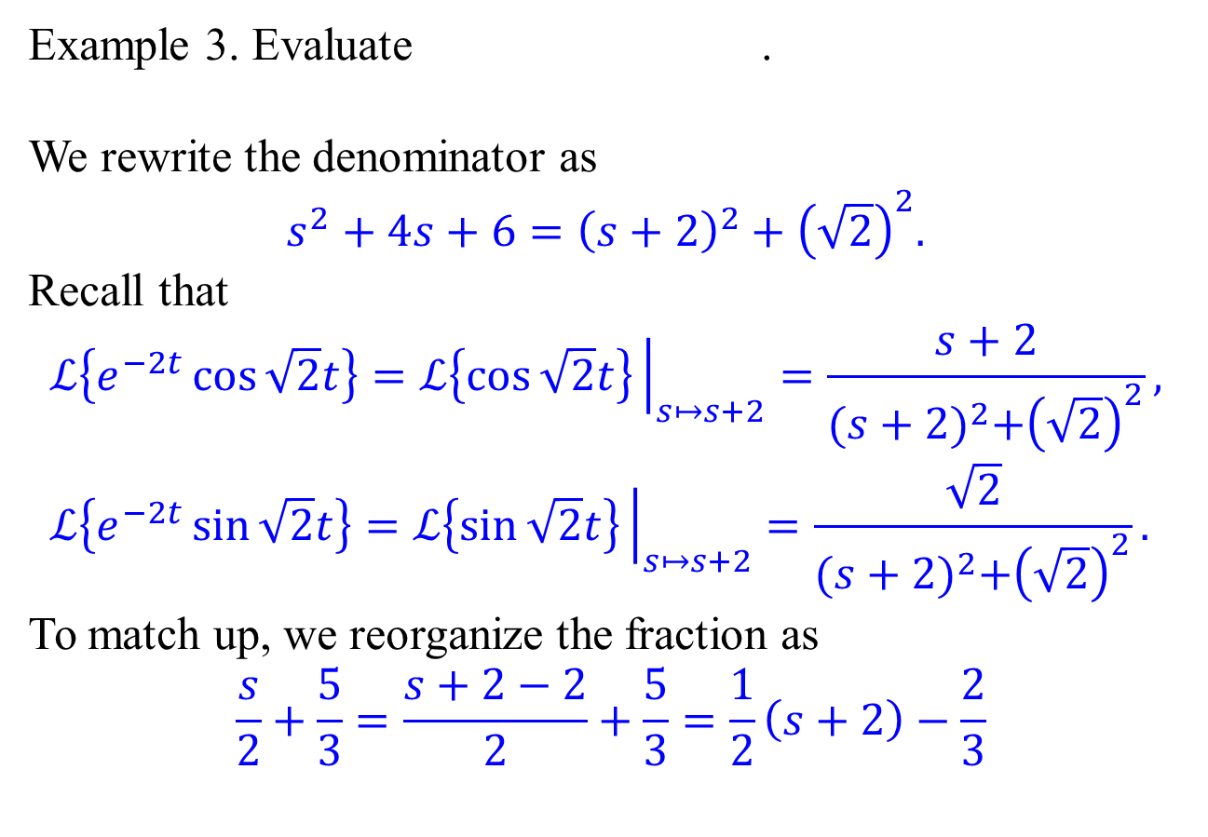
First Translation Theorem – Applications
$$ℒ^{−1}\left\{\frac{s/2+5/3}{s^{2}+4s+6}\right\}$$
Example 3. Evaluate .
We rewrite the denominator as
$$s^{2}+4s+6={\left(s+2\right)}^{2}+{\left(\sqrt{2}\right)}^{2}.$$
Recall that
$$ℒ\left\{e^{−2t}\cos{\sqrt{2}t}\right\}=ℒ\left\{\cos{\sqrt{2}t}\right\}{\left.​\right|}_{s↦s+2}=\frac{s+2}{{(s+2)}^{2}+{\left(\sqrt{2}\right)}^{2}}, \\ ℒ\left\{e^{−2t}\sin{\sqrt{2}t}\right\}=ℒ\left\{\sin{\sqrt{2}t}\right\}{\left.​\right|}_{s↦s+2}=\frac{\sqrt{2}}{{(s+2)}^{2}+{\left(\sqrt{2}\right)}^{2}}.$$
To match up, we reorganize the fraction as
$$\frac{s}{2}+\frac{5}{3}=\frac{s+2−2}{2}+\frac{5}{3}=\frac{1}{2}\left(s+2\right)−\frac{2}{3}$$

Slide 6
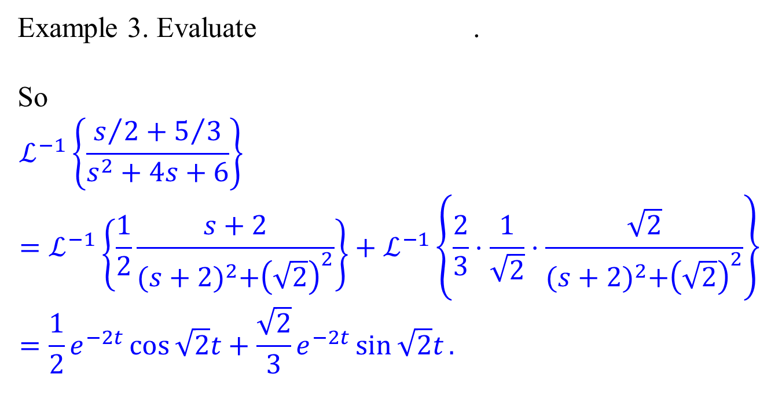
First Translation Theorem – Applications
$$ℒ^{−1}\left\{\frac{s/2+5/3}{s^{2}+4s+6}\right\}$$
Example 3. Evaluate .
So
$$ℒ^{−1}\left\{\frac{s/2+5/3}{s^{2}+4s+6}\right\}=ℒ^{−1}\left\{\frac{1}{2}\frac{s+2}{{(s+2)}^{2}+{\left(\sqrt{2}\right)}^{2}}\right\}+ℒ^{−1}\left\{\frac{2}{3}⋅\frac{1}{\sqrt{2}}⋅\frac{\sqrt{2}}{{(s+2)}^{2}+{\left(\sqrt{2}\right)}^{2}}\right\} \\ =\frac{1}{2}e^{−2t}\cos{\sqrt{2}t}+\frac{\sqrt{2}}{3}e^{−2t}\sin{\sqrt{2}t}.$$

Slide 7
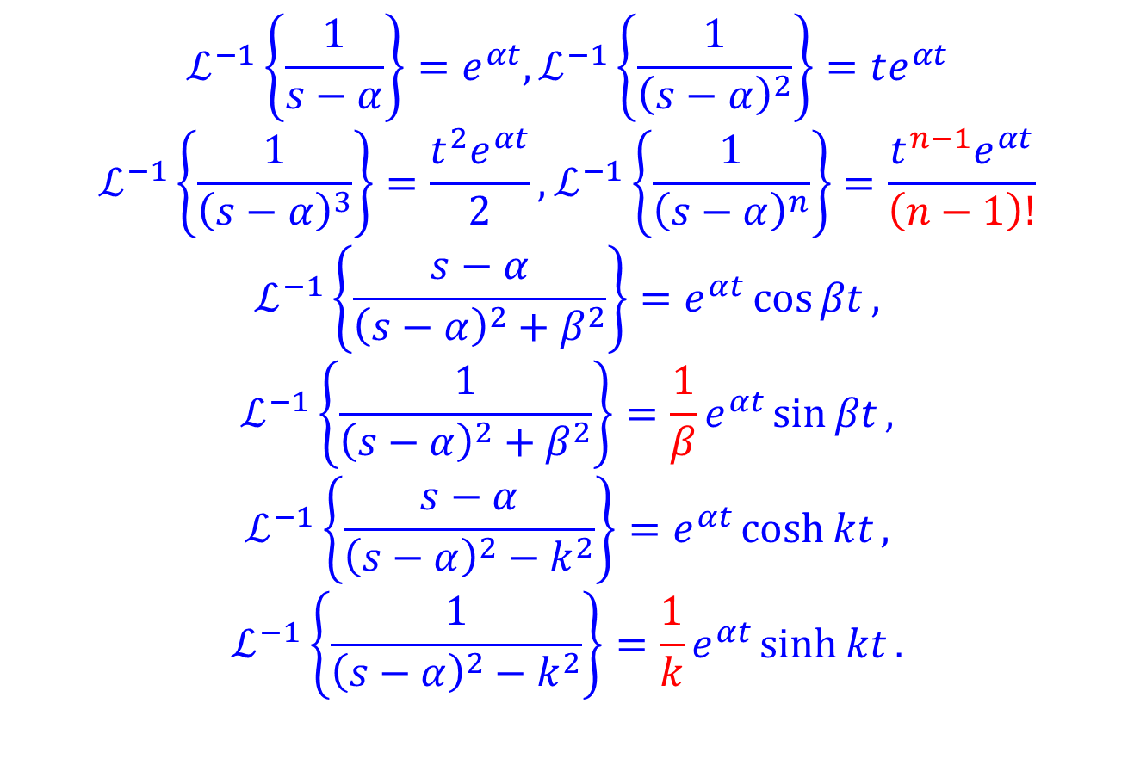
Important formulas to keep in mind
$$ℒ^{−1}\left\{\frac{1}{s−α}\right\}=e^{αt},ℒ^{−1}\left\{\frac{1}{{\left(s−α\right)}^{2}}\right\}=te^{αt}$$
$$ℒ^{−1}\left\{\frac{1}{{\left(s−α\right)}^{3}}\right\}=\frac{t^{2}e^{αt}}{2}, ℒ^{−1}\left\{\frac{1}{{\left(s−α\right)}^{n}}\right\}=\frac{t^{n−1}e^{αt}}{\left(n−1\right)!}$$
$$ℒ^{−1}\left\{\frac{s−α}{{\left(s−α\right)}^{2}+β^{2}}\right\}=e^{αt}\cos{βt},$$
$$ℒ^{−1}\left\{\frac{1}{{\left(s−α\right)}^{2}+β^{2}}\right\}=\frac{1}{β}e^{αt}\sin{βt},$$
$$ℒ^{−1}\left\{\frac{s−α}{{\left(s−α\right)}^{2}−k^{2}}\right\}=e^{αt}\cosh{kt},$$
$$ℒ^{−1}\left\{\frac{1}{{\left(s−α\right)}^{2}−k^{2}}\right\}=\frac{1}{k}e^{αt}\sinh{kt}.$$

Slide 8
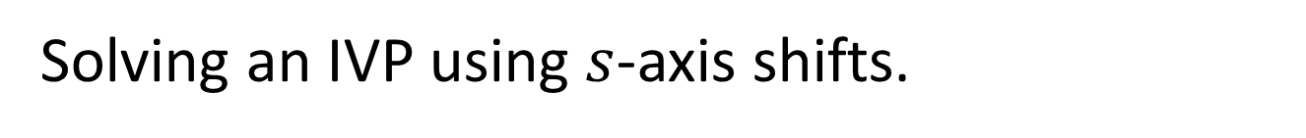
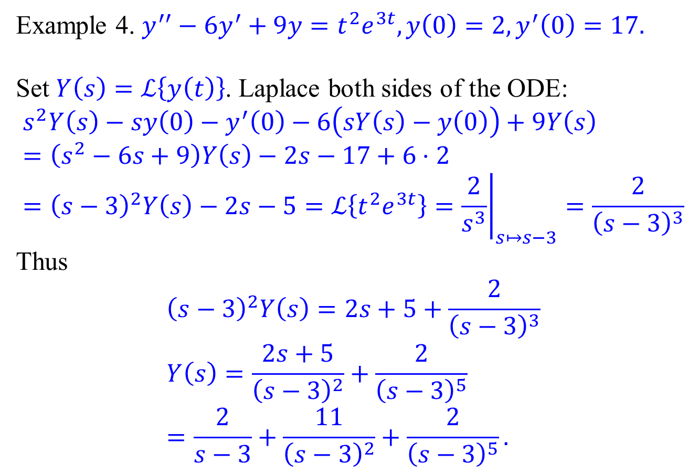
Solving an IVP using $s$-axis shifts.
Example 4. $y^{′′}−6y^{′}+9y=t^{2}e^{3t},y\left(0\right)=2,y^{′}\left(0\right)=17.$
Set $Y\left(s\right)=ℒ\left\{y\left(t\right)\right\}$. Laplace both sides of the ODE:
$$s^{2}Y\left(s\right)−sy\left(0\right)−y^{′}\left(0\right)−6\left(sY\left(s\right)−y\left(0\right)\right)+9Y\left(s\right) \\ =\left(s^{2}−6s+9\right)Y\left(s\right)−2s−17+6⋅2 \\ ={\left(s−3\right)}^{2}Y\left(s\right)−2s−5=ℒ\left\{t^{2}e^{3t}\right\}={\left.\frac{2}{s^{3}}\right|}_{s↦s−3}=\frac{2}{{\left(s−3\right)}^{3}}$$
Thus
$${\left(s−3\right)}^{2}Y\left(s\right)=2s+5+\frac{2}{{\left(s−3\right)}^{3}} \\ Y\left(s\right)=\frac{2s+5}{{\left(s−3\right)}^{2}}+\frac{2}{{\left(s−3\right)}^{5}} \\ =\frac{2}{s−3}+\frac{11}{{\left(s−3\right)}^{2}}+\frac{2}{{\left(s−3\right)}^{5}}.$$

Slide 9
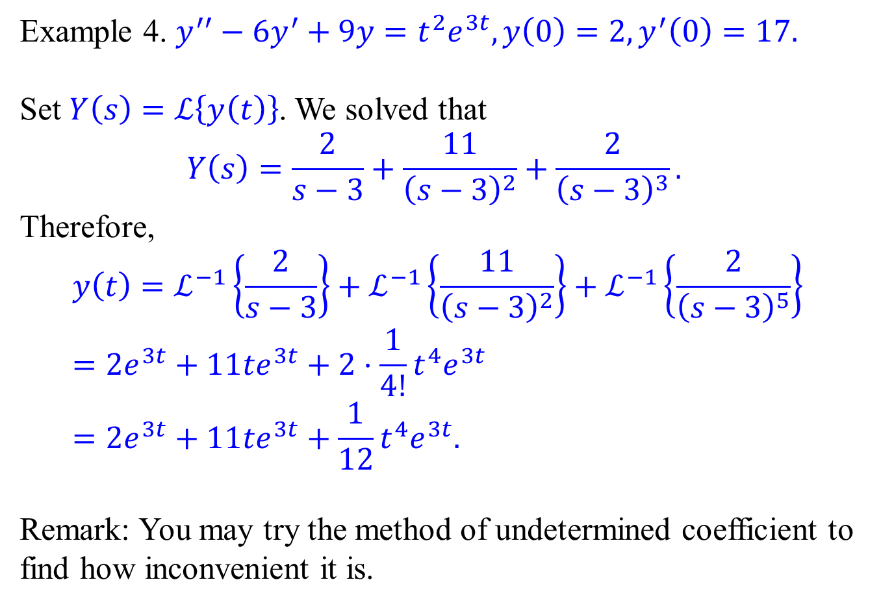
Solving an IVP using $s$-axis shifts.
Example 4. $y^{′′}−6y^{′}+9y=t^{2}e^{3t},y\left(0\right)=2,y^{′}\left(0\right)=17.$
Set $Y\left(s\right)=ℒ\left\{y\left(t\right)\right\}$. We solved that
$$Y\left(s\right)=\frac{2}{s−3}+\frac{11}{{\left(s−3\right)}^{2}}+\frac{2}{{\left(s−3\right)}^{3}}.$$
Therefore,
$$y\left(t\right)=ℒ^{−1}\left\{\frac{2}{s−3}\right\}+ℒ^{−1}\left\{\frac{11}{{\left(s−3\right)}^{2}}\right\}+ℒ^{−1}\left\{\frac{2}{{\left(s−3\right)}^{5}}\right\} \\ =2e^{3t}+11te^{3t}+2⋅\frac{1}{4!}t^{4}e^{3t} \\ =2e^{3t}+11te^{3t}+\frac{1}{12}t^{4}e^{3t}.$$
Remark: You may try the method of undetermined coefficient to find how inconvenient it is.

Slide 10
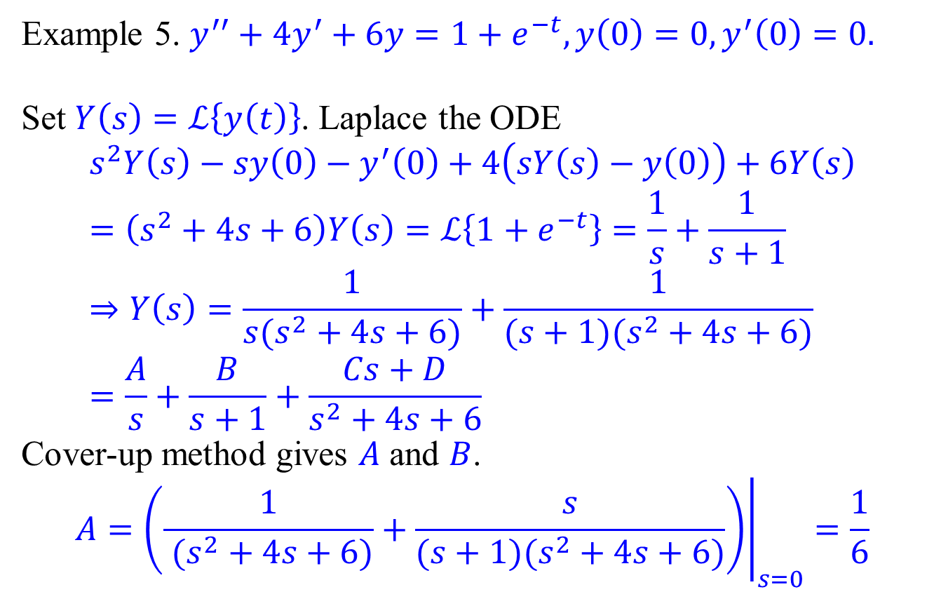
Solving an IVP using $s$-axis shifts.
Example 5. $y^{′′}+4y^{′}+6y=1+e^{−t},y\left(0\right)=0,y^{′}\left(0\right)=0.$
Set $Y\left(s\right)=ℒ\left\{y\left(t\right)\right\}$. Laplace the ODE
$$s^{2}Y\left(s\right)−sy\left(0\right)−y^{′}\left(0\right)+4\left(sY\left(s\right)−y\left(0\right)\right)+6Y\left(s\right) \\ =\left(s^{2}+4s+6\right)Y\left(s\right)=ℒ\left\{1+e^{−t}\right\}=\frac{1}{s}+\frac{1}{s+1} \\ ⇒Y\left(s\right)=\frac{1}{s(s^{2}+4s+6)}+\frac{1}{(s+1)(s^{2}+4s+6)} \\ =\frac{A}{s}+\frac{B}{s+1}+\frac{Cs+D}{s^{2}+4s+6}$$
Cover-up method gives $A$ and $B$.
$$A={\left.\left(\frac{1}{ (s^{2}+4s+6)}+\frac{s}{(s+1)(s^{2}+4s+6)}\right)\right|}_{s=0}=\frac{1}{6}$$

Slide 11
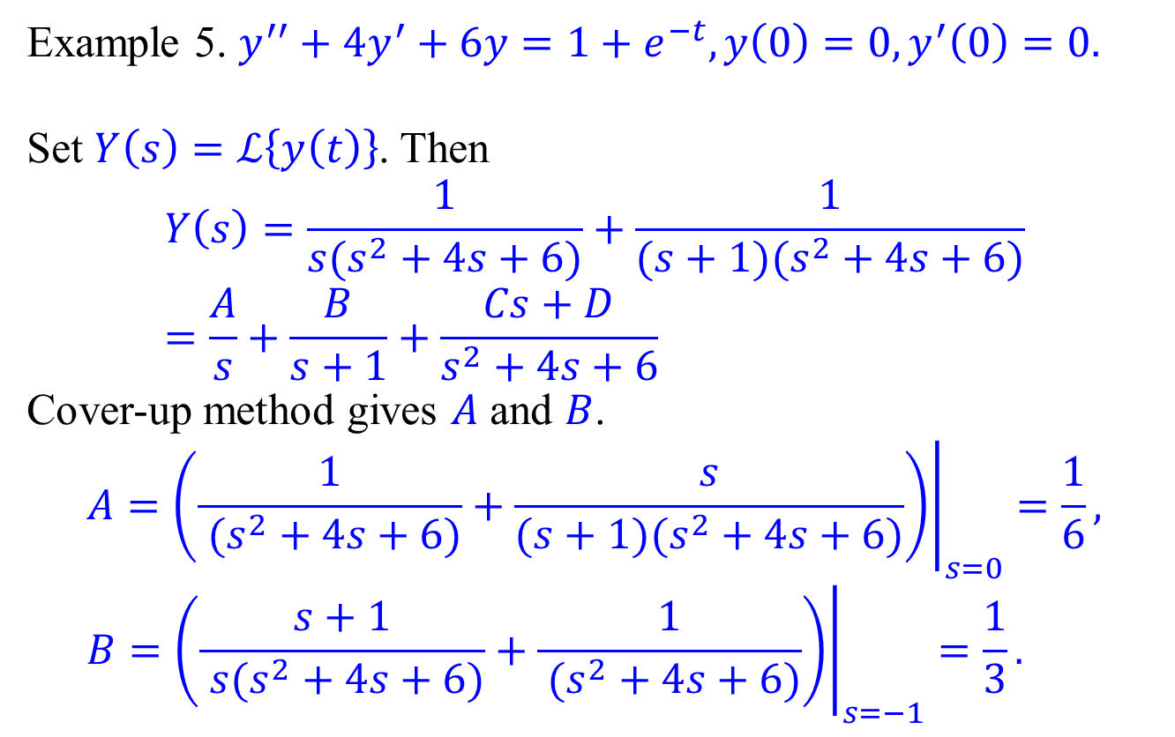
Solving an IVP using $s$-axis shifts.
Example 5. $y^{′′}+4y^{′}+6y=1+e^{−t},y\left(0\right)=0,y^{′}\left(0\right)=0.$
Set $Y\left(s\right)=ℒ\left\{y\left(t\right)\right\}$. Then $$Y\left(s\right)=\frac{1}{s(s^{2}+4s+6)}+\frac{1}{(s+1)(s^{2}+4s+6)}=\frac{A}{s}+\frac{B}{s+1}+\frac{Cs+D}{s^{2}+4s+6}$$
Cover-up method gives $A$ and $B$.
$$A={\left.\left(\frac{1}{ (s^{2}+4s+6)}+\frac{s}{(s+1)(s^{2}+4s+6)}\right)\right|}_{s=0}=\frac{1}{6}, \\ B={\left.\left(\frac{s+1}{ s(s^{2}+4s+6)}+\frac{1}{ (s^{2}+4s+6)}\right)\right|}_{s=−1}=\frac{1}{3}.$$

Slide 12
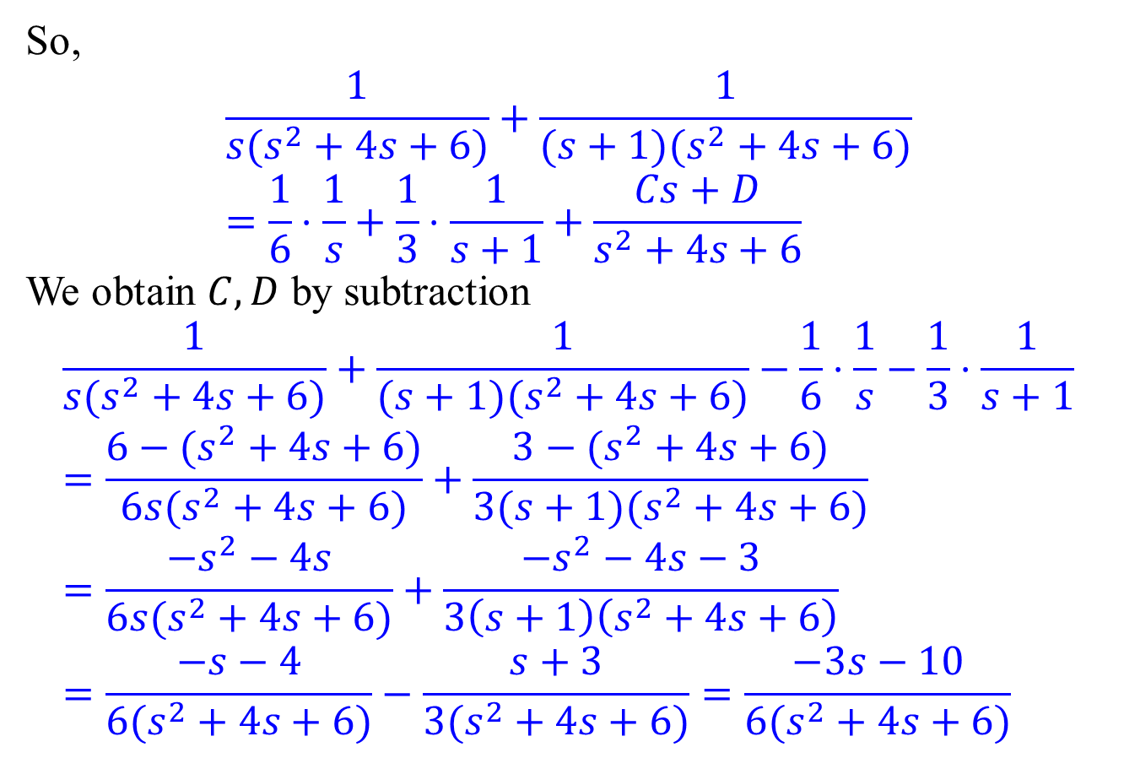
Solving an IVP using $s$-axis shifts.
So,
$$\frac{1}{s(s^{2}+4s+6)}+\frac{1}{(s+1)(s^{2}+4s+6)}=\frac{1}{6}⋅\frac{1}{s}+\frac{1}{3}⋅\frac{1}{s+1}+\frac{Cs+D}{s^{2}+4s+6}$$
We obtain $C,D$ by subtraction
$$\frac{1}{s(s^{2}+4s+6)}+\frac{1}{(s+1)(s^{2}+4s+6)}−\frac{1}{6}⋅\frac{1}{s}−\frac{1}{3}⋅\frac{1}{s+1} \\ =\frac{6−(s^{2}+4s+6)}{6s(s^{2}+4s+6)}+\frac{3−(s^{2}+4s+6)}{3(s+1)(s^{2}+4s+6)} \\ =\frac{{−s}^{2}−4s}{6s(s^{2}+4s+6)}+\frac{−s^{2}−4s−3}{3\left(s+1\right)\left(s^{2}+4s+6\right)} \\ =\frac{−s−4}{6(s^{2}+4s+6)}−\frac{s+3}{3(s^{2}+4s+6)}=\frac{−3s−10}{6(s^{2}+4s+6)}$$

Slide 13
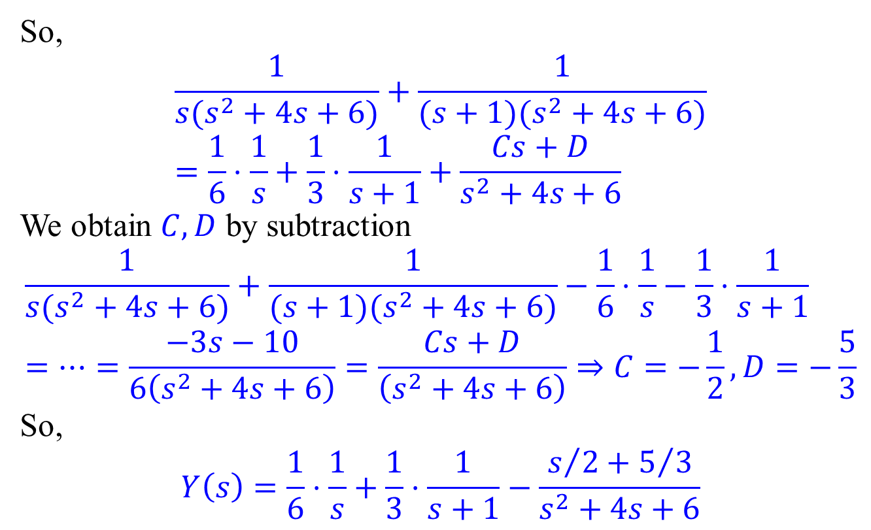
Solving an IVP using $s$-axis shifts.
So,
$$\frac{1}{s(s^{2}+4s+6)}+\frac{1}{(s+1)(s^{2}+4s+6)}=\frac{1}{6}⋅\frac{1}{s}+\frac{1}{3}⋅\frac{1}{s+1}+\frac{Cs+D}{s^{2}+4s+6}$$
We obtain $C,D$ by subtraction
$$\frac{1}{s(s^{2}+4s+6)}+\frac{1}{(s+1)(s^{2}+4s+6)}−\frac{1}{6}⋅\frac{1}{s}−\frac{1}{3}⋅\frac{1}{s+1} \\ =⋯=\frac{−3s−10}{6\left(s^{2}+4s+6\right)}=\frac{Cs+D}{\left(s^{2}+4s+6\right)}⇒C=−\frac{1}{2},D=−\frac{5}{3}$$
So,
$$Y\left(s\right)=\frac{1}{6}⋅\frac{1}{s}+\frac{1}{3}⋅\frac{1}{s+1}−\frac{s/2+5/3}{s^{2}+4s+6}$$

Slide 14
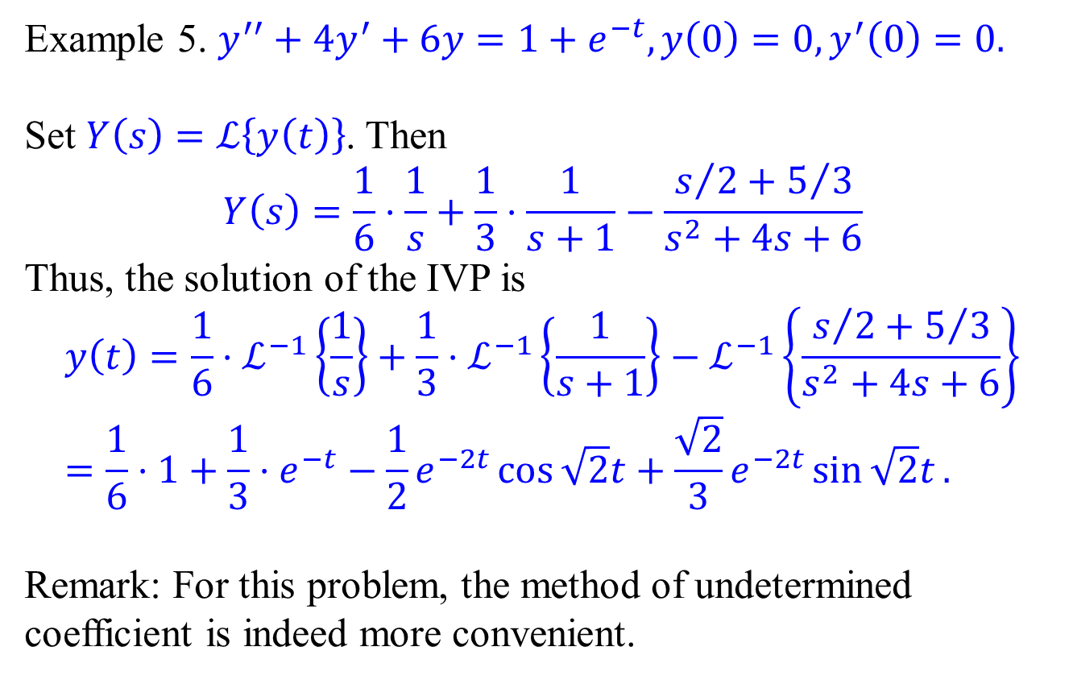
Solving an IVP using $s$-axis shifts.
Example 5. $y^{′′}+4y^{′}+6y=1+e^{−t},y\left(0\right)=0,y^{′}\left(0\right)=0.$
Set $Y\left(s\right)=ℒ\left\{y\left(t\right)\right\}$. Then $$Y\left(s\right)=\frac{1}{6}⋅\frac{1}{s}+\frac{1}{3}⋅\frac{1}{s+1}−\frac{s/2+5/3}{s^{2}+4s+6}$$
Thus, the solution of the IVP is
$$y\left(t\right)=\frac{1}{6}⋅ℒ^{−1}\left\{\frac{1}{s}\right\}+\frac{1}{3}⋅ℒ^{−1}\left\{\frac{1}{s+1}\right\}−ℒ^{−1}\left\{\frac{s/2+5/3}{s^{2}+4s+6}\right\} \\ =\frac{1}{6}⋅1+\frac{1}{3}⋅e^{−t}−\frac{1}{2}e^{−2t}\cos{\sqrt{2}t}+\frac{\sqrt{2}}{3}e^{−2t}\sin{\sqrt{2}t}.$$
Remark: For this problem, the method of undetermined coefficient is indeed more convenient.

